Slide 1


A Tour of the Chelmer Speakers
Club Website for Members and Guests presented by Phil Scorey - 20 April 2016

Slide 2
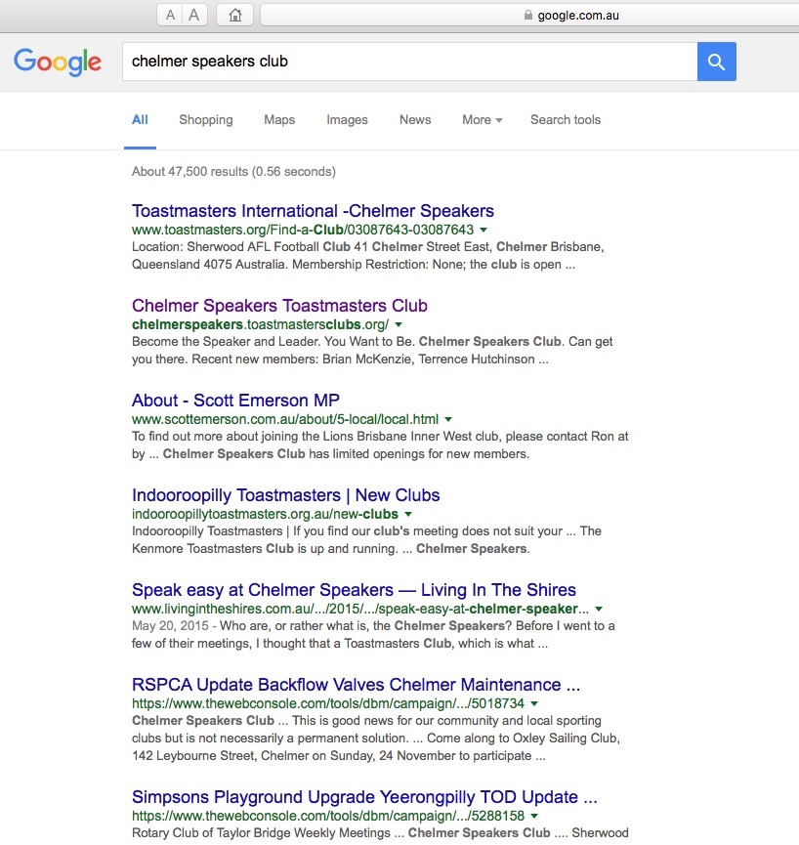
Chelmers Speakers Club Website was started in October 2015 is based on
Free ToastHoast2 website and comes with easy-to-use web-based software.
FreeToastHost2 was created by a Toastmaster, and is maintained and supported by a group of Toastmasters – Pam Holley is our local support Toastmaster

Slide 3
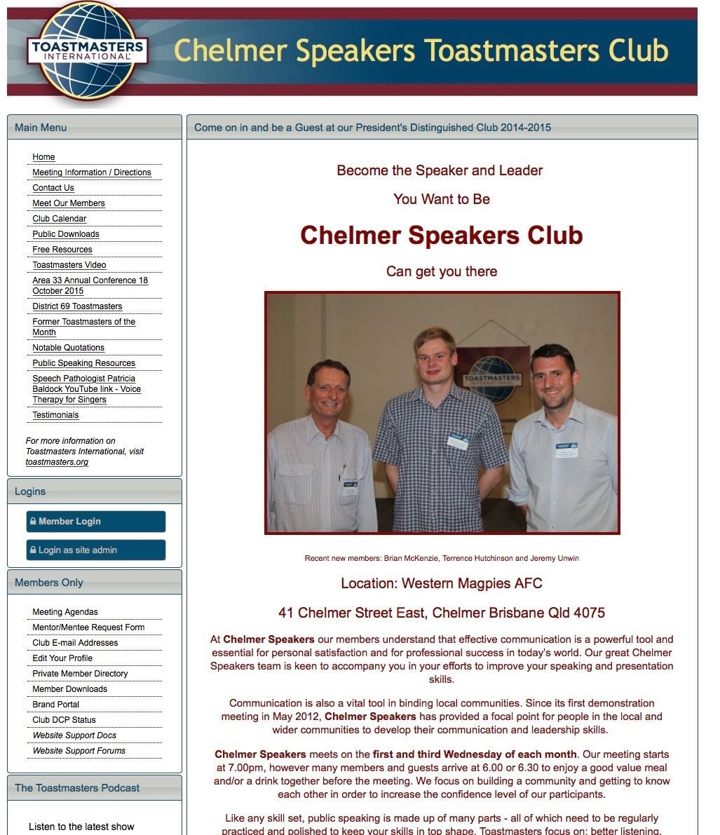
Main Menu:
Items are all accessible to anyone who accesses the Home Page
The Home Page:
Generally explains general information about the club and the benefits of being part of the Club

Slide 4
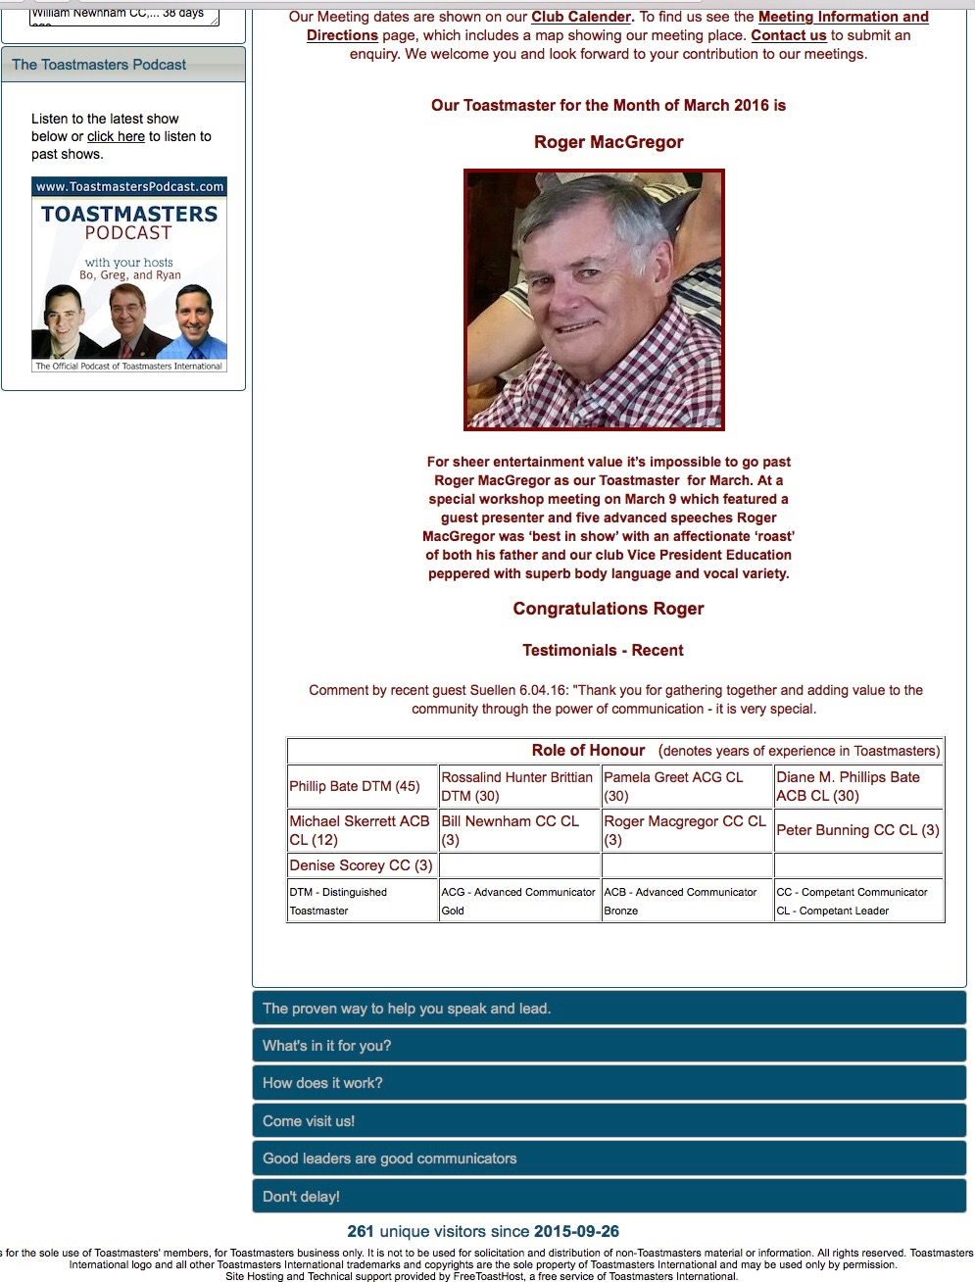
Scrolling down the Home Page
You will notice Hot links to:
- Club Calender
- Meeting Information and - Directions to the Club &
- How to Contact us
Includes:
The Toastmaster of the Month
A Recent Testimonial
Role of Honour
- Includes the number of years experience by each Toastmaster honoured.
The Blue bars is general Information about Toastmasters
At the very bottom you will notice
261 unique visitors since 2015-09.26

Slide 5
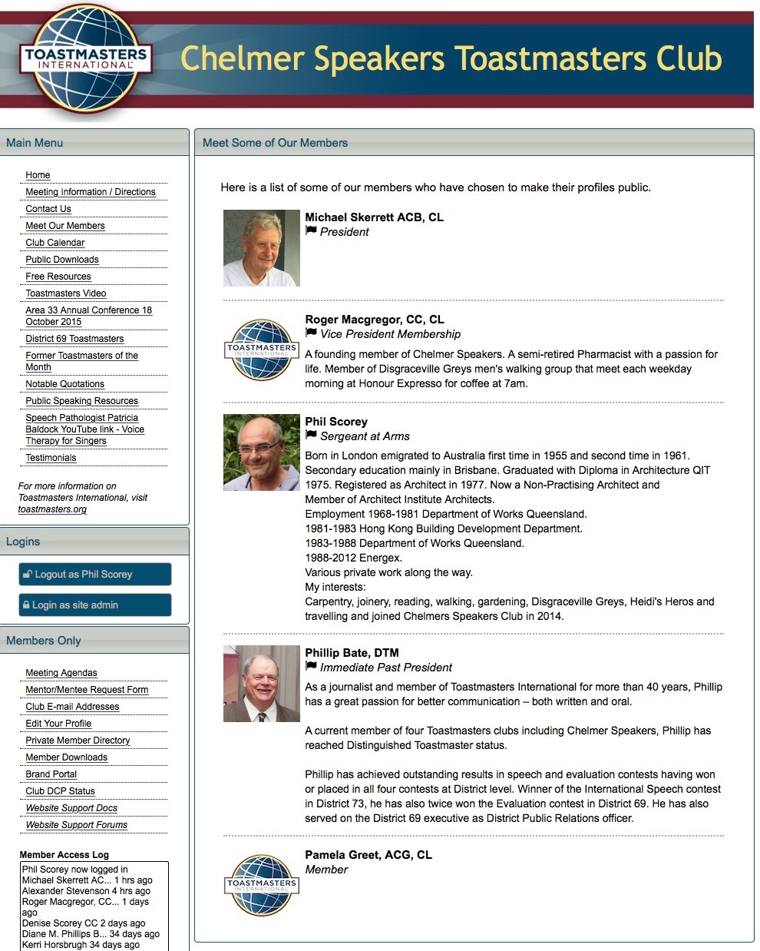
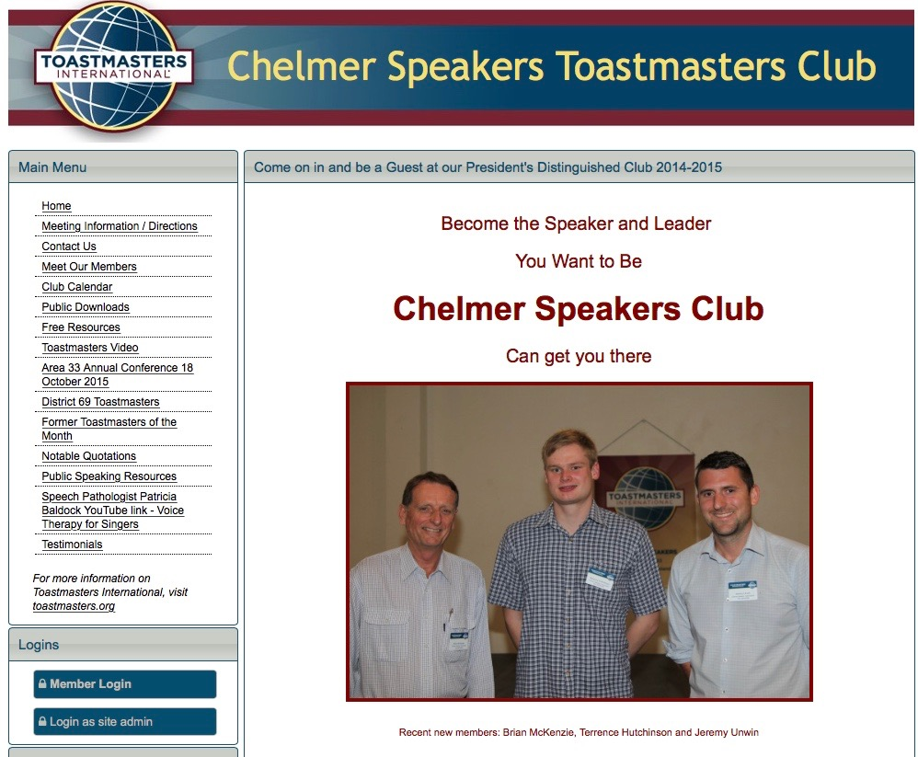
A few examples are as follows:
1. Meet our Members:

Slide 6
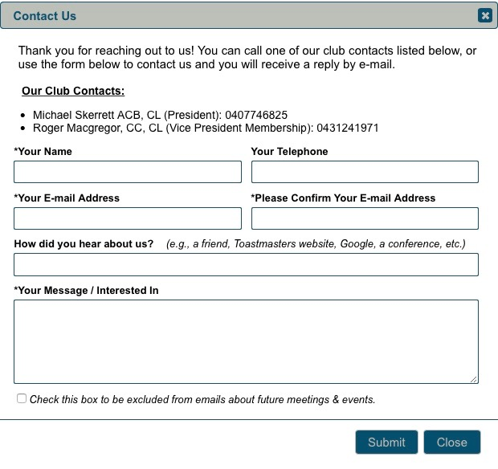
A few examples are as follows:
2. Contact Us:

Slide 7
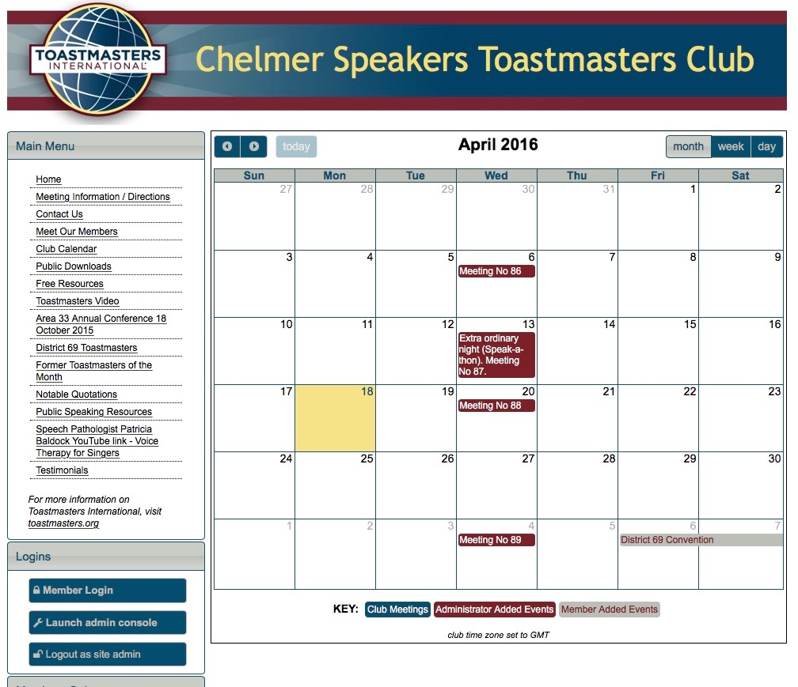
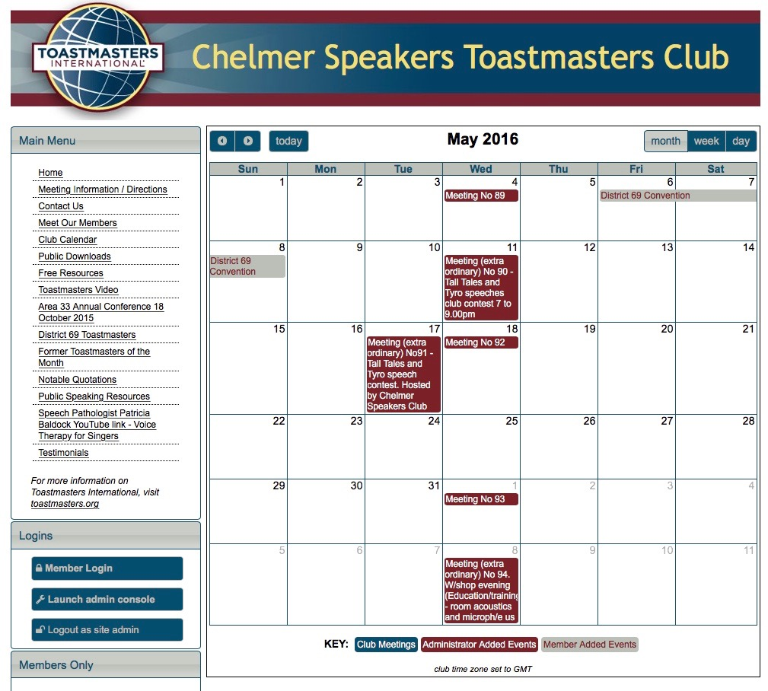
3. Club Calender – for April & May 2016 included as examples

Slide 8
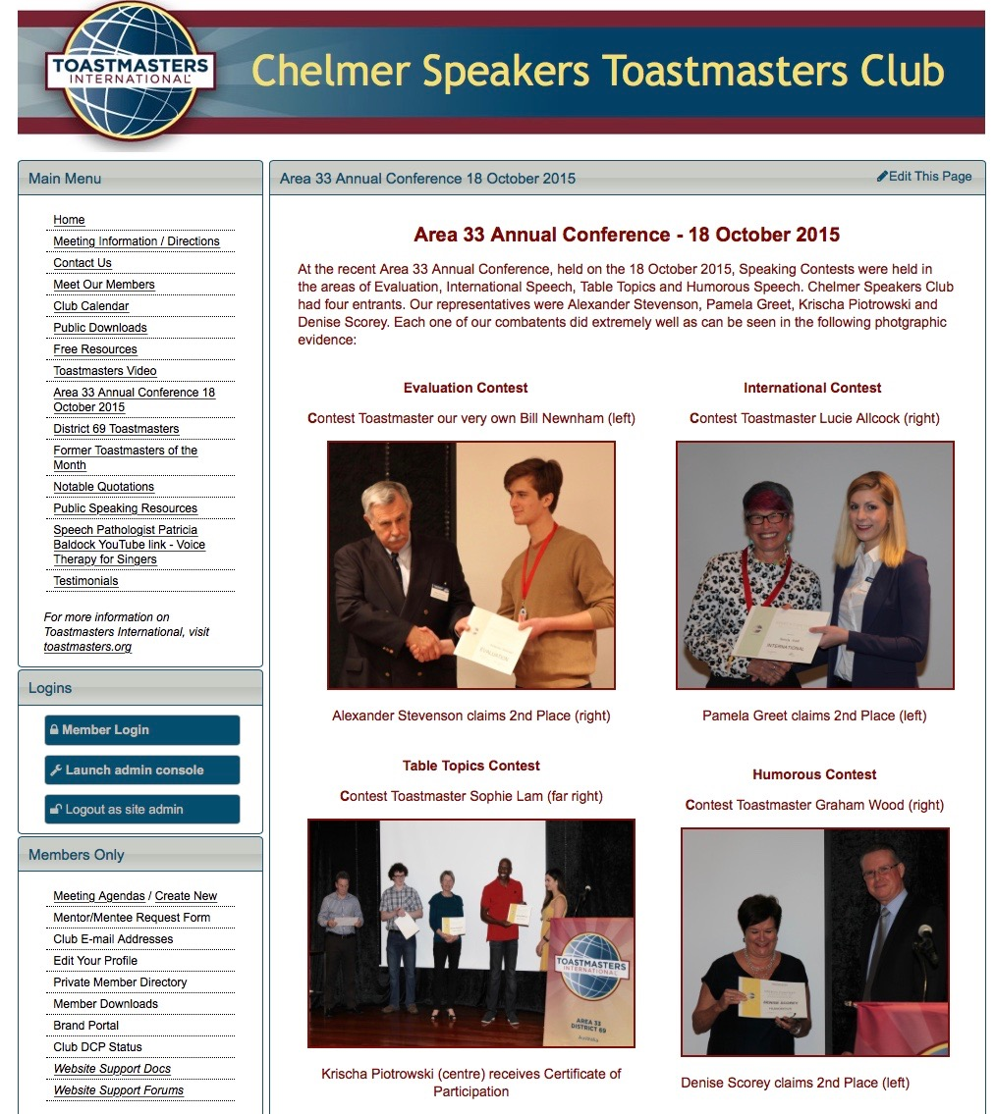
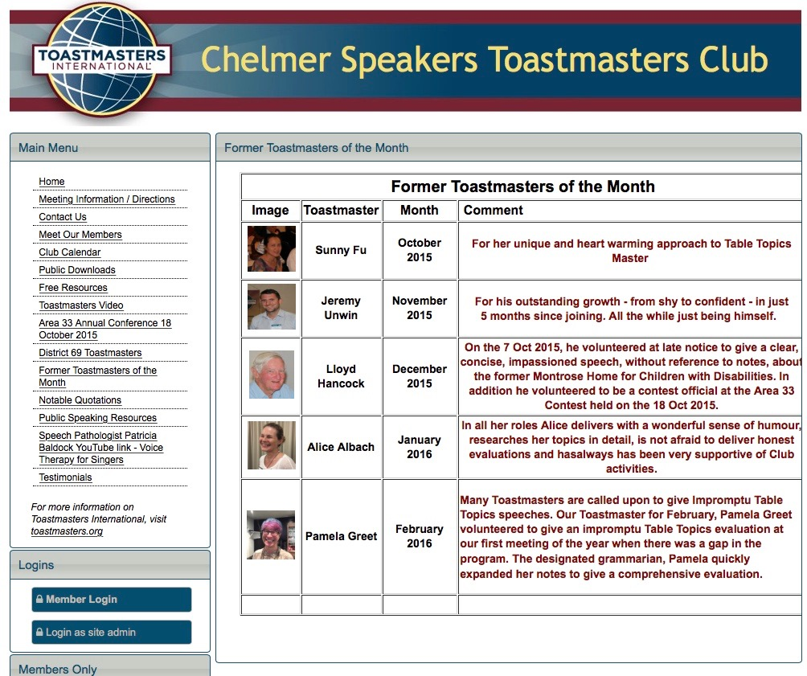
4. Area 33 Annual Conference:
This has added by the Website Administrator (Social event that we want to share)
5. Former Toastmasters of the Month:

Slide 9
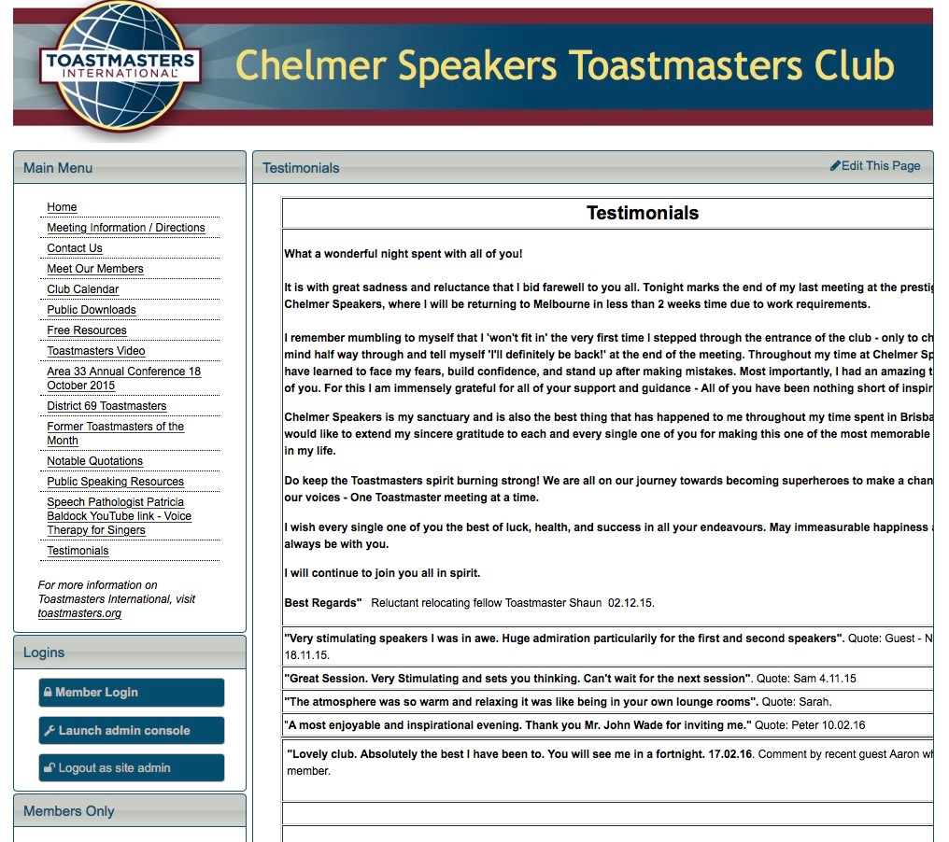
6. Testimonials:
This has added by the Website Administrator represents what has been written in the Guest Register only

Slide 10
In Summary Menu that can be viewed by all who visit the website (only a few items mentioned
1. Contact Us either Michael Skerrett President or Roger Macgregor VPM via phone or email
2. Meet our Members
3. Club Calender
4. Area 33 Annual Conference
5. Former Toastmasters of the Month
6. Testimonials
1
2
3
4
5
6

Slide 11
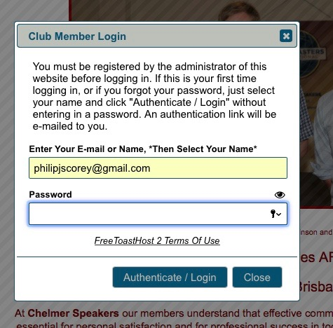
.
To Login as a Member:
To log in for the first time
Having accessed the Home Page
Then move curser over the blued out bar with” “Login as a Member“ on it then follow the prompts “Enter your Email or Name”. Just leave the password section blank and click the "Authorise / Login" button. You will be sent a login link via e-mail. Click that link, then you will be prompted to set up a custom password. This is a password that you create, it has not been assigned. From then on it is just a matter of entering your email address or your name and passwood.

Slide 12
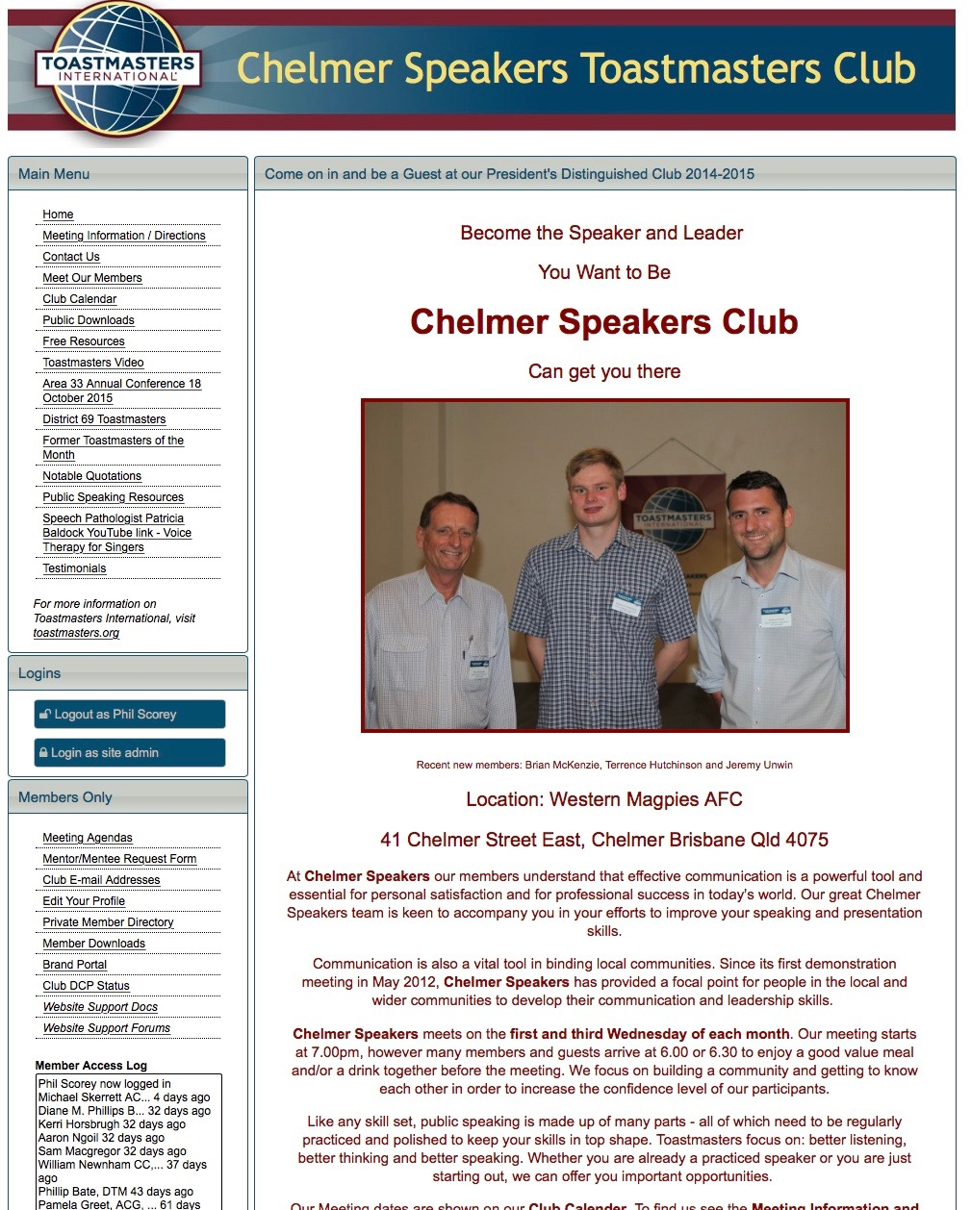
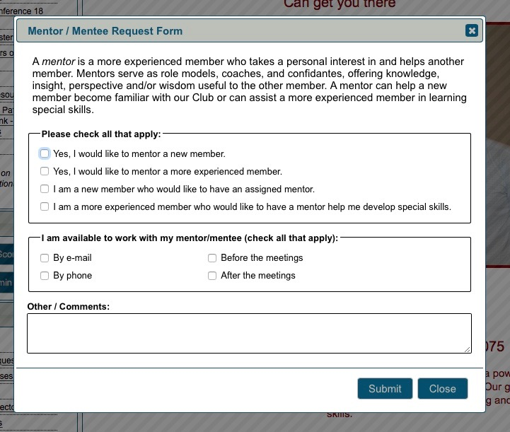
.For Members Only:
The following are a few reasons why it is it is worthwhile being actively involved with the website:
1. You can request to have a Mentor
* The Club has chosen not to use the Meetings Agenda software at this stage
1

Slide 13
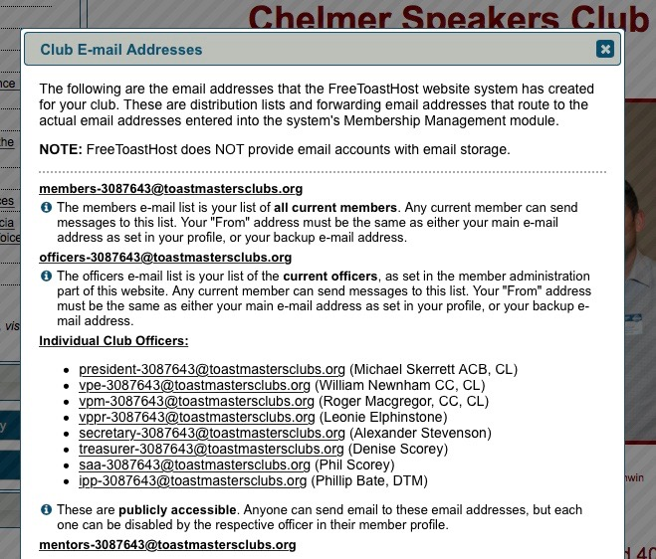
2. Club Email Addresses.
Allows to contact other club members. These are publicly accessible. Anyone can send email to these email addresses, but each one can be disabled by the respective officer in their member profile.
2

Slide 14
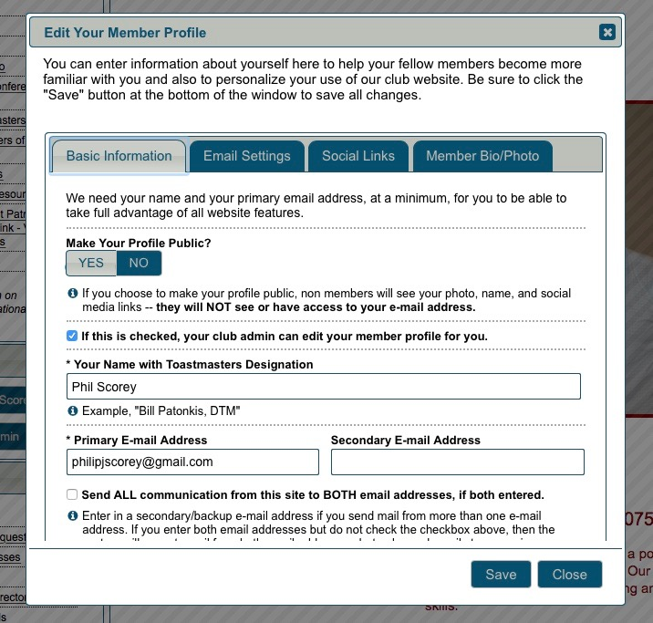
3. You can Edit your Member Profile
All four tabs can be edited however only one tab is shown here Basic Information. The next slide shows the forth tab.
3

Slide 15
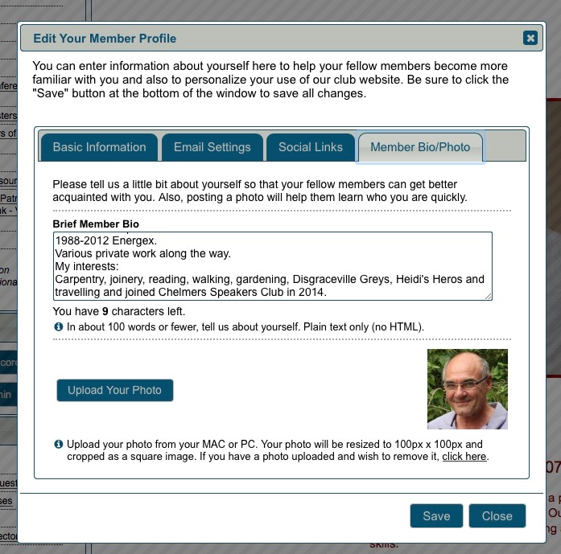
3. (Tab) Member Bio/Photo
3

Slide 16
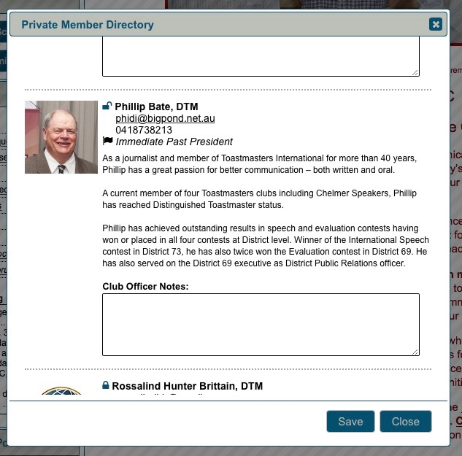
4. Private Member Directory
Gives a snapshot of the members in the Club
4

Slide 17
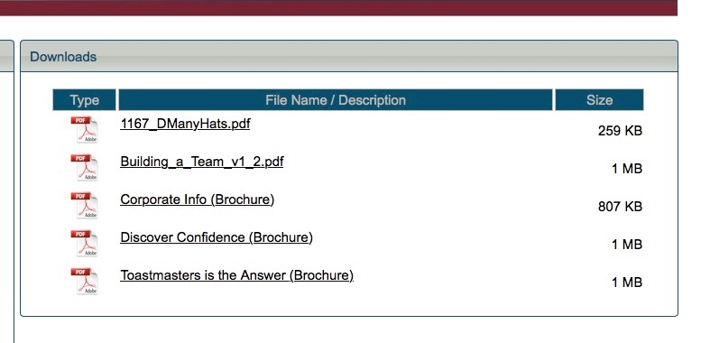
.
5. Member Downloads:
These are some documents that are accessable by Members for training and information purposes from Toastmasters International.
It is also an area where we can add our own documents see –
“Building a Team”.
You will also note that this PowerPoint presentation -
”A Tour of the Chelmer Speakers Club Website for Members and Guests” has been added here and it can be viewed in the Public Area as well under Public Speaking Resources.
5

Slide 18
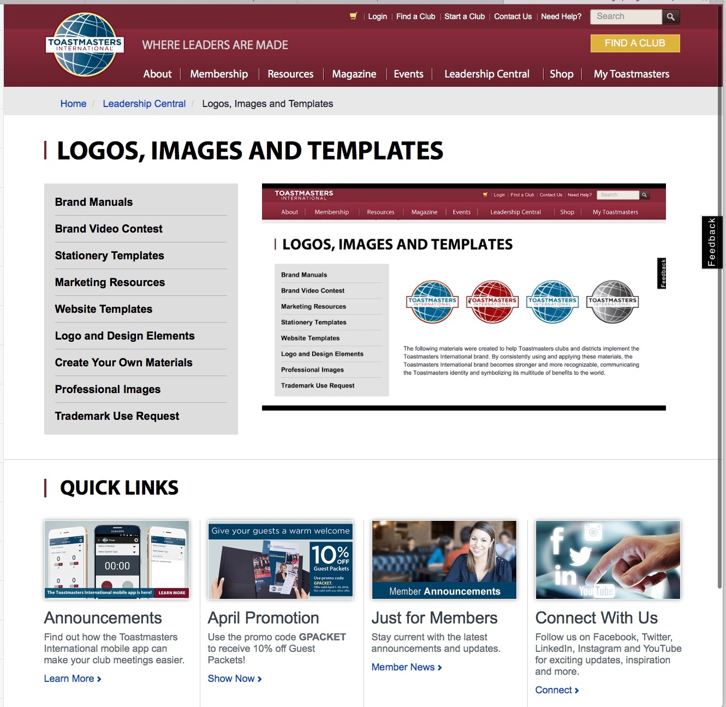
.
6. Brand Portal:
Logos, Images and Templates
6

Slide 19
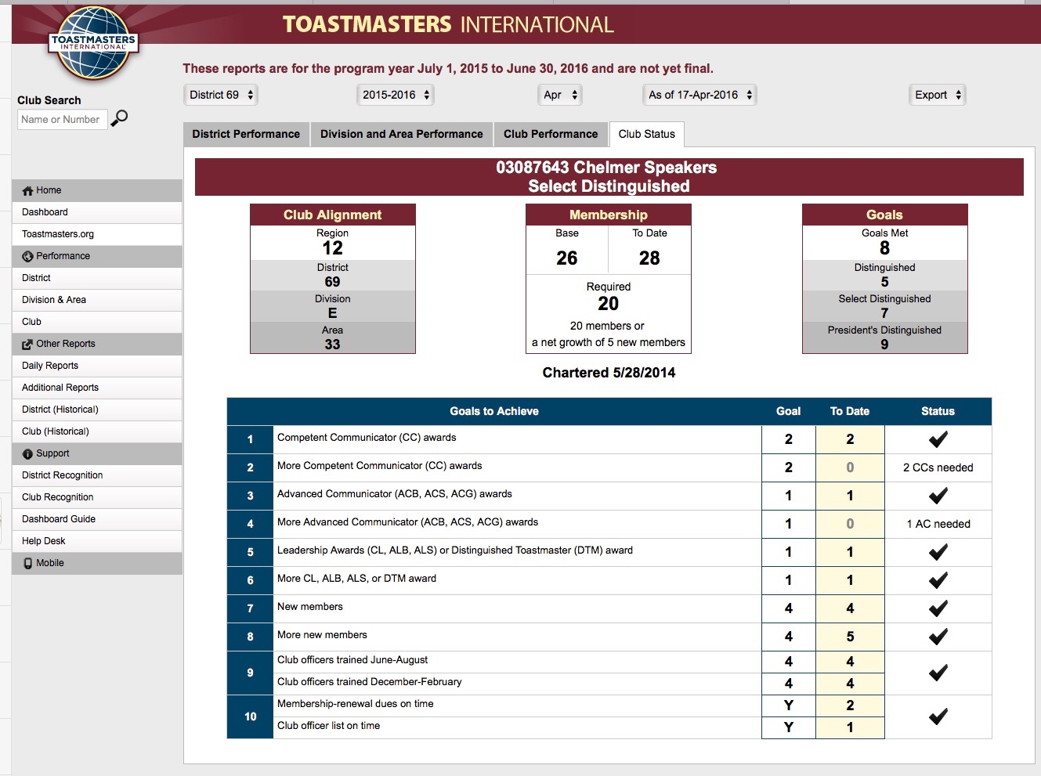
.
7. Club DCP Status:
Snap shot as of 20.04.16. We have 8 goals met (according to the Chart Below) but in reality all the goals have been met to be President’s Distinguished Club for the 2nd Year in a row – an excellent result since we were only chartered on 28.05.14.
7

Slide 20
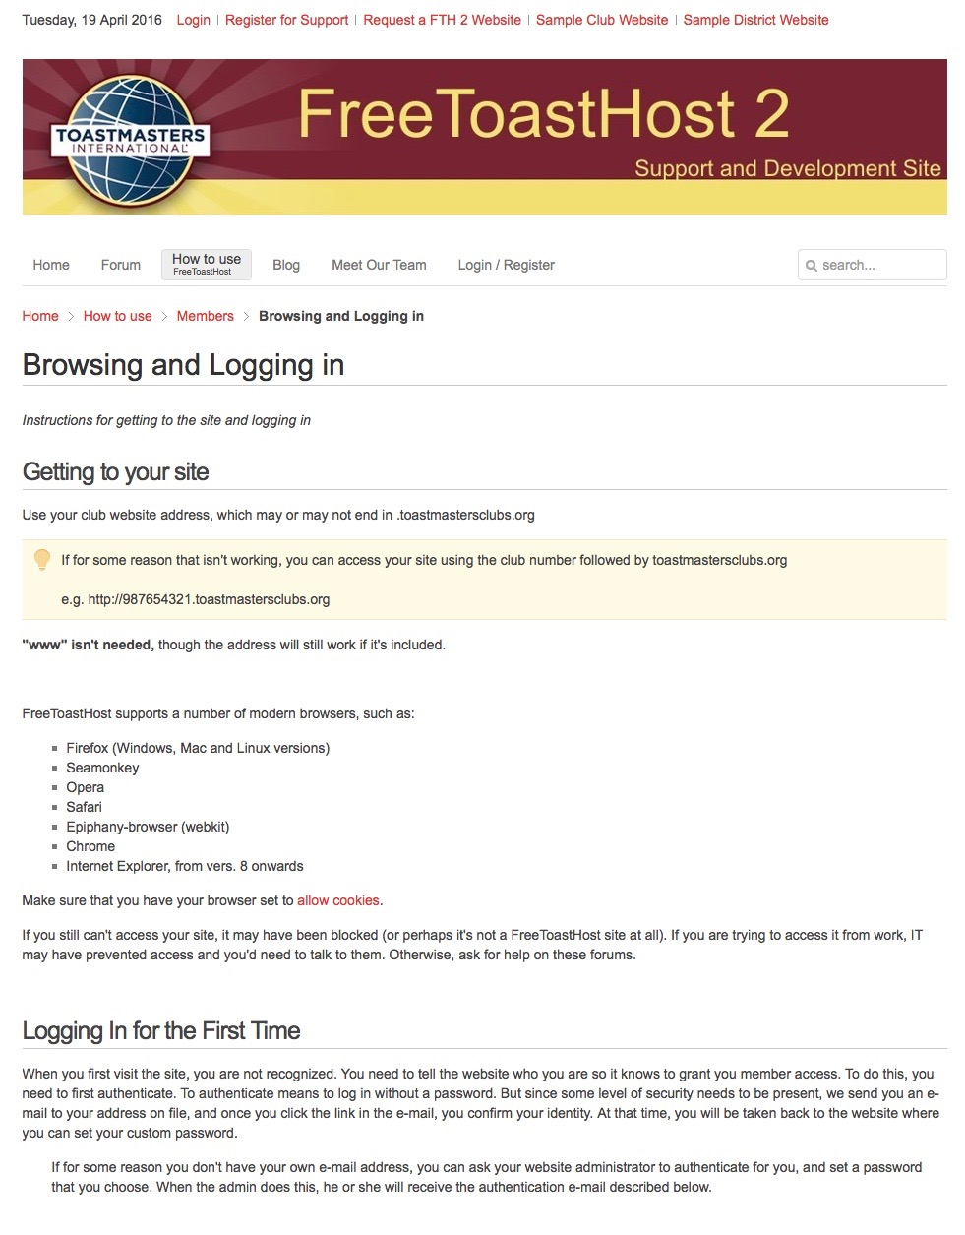
8. Website Support Documentation:
8

Slide 21
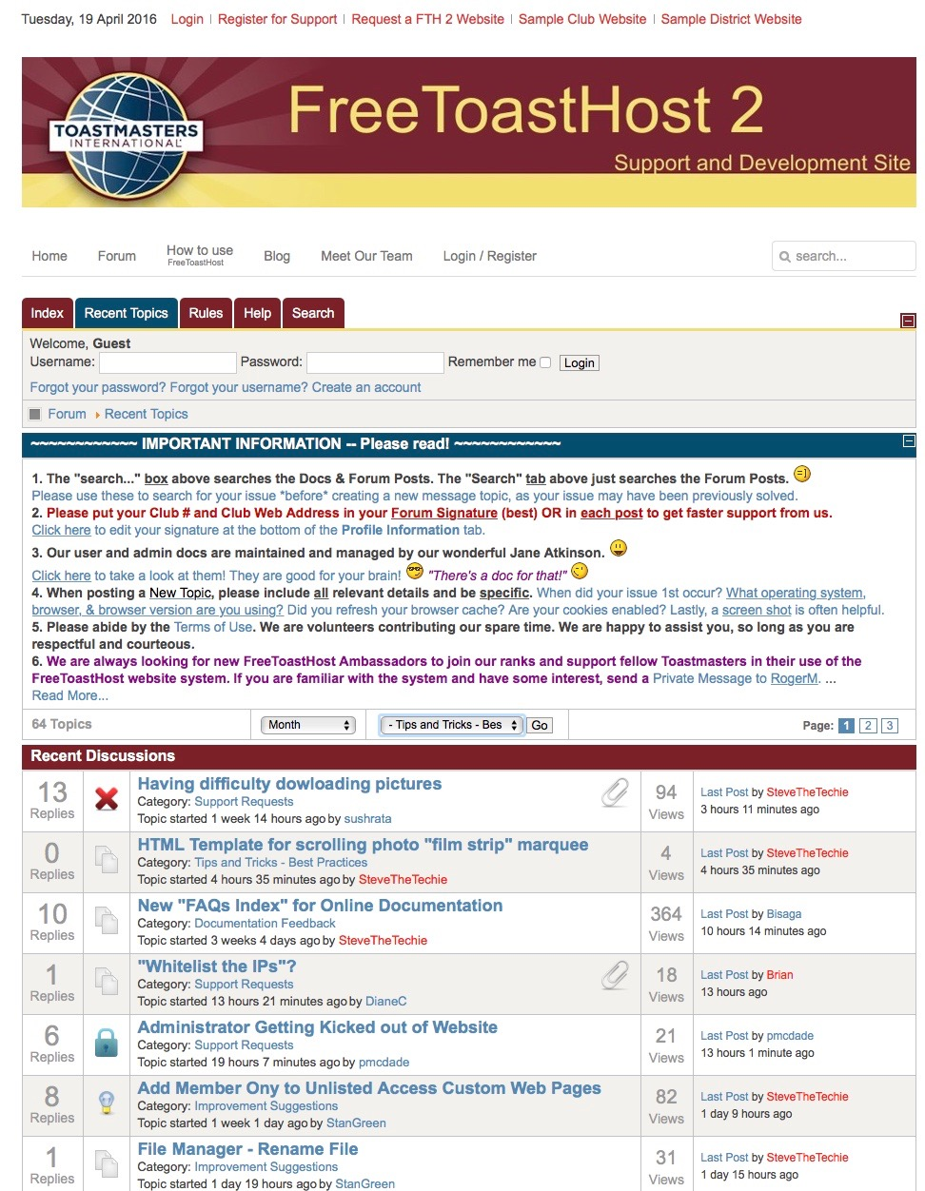
.
9. Website Support Forums:
9

Slide 22
To Conclude: checking on the Website as a Member has the following Benefits:
1. You can request to have a Mentor
2. You can contact members of the Club Executive via email
3. Edit Your Profile
4. Private Member Directory
5. Members downloads
6. Brand Portal
7. Club DCP Status
8. Club Website Support Docs
9. Website Support Docs
1
3
2
5
4
7
6
8
9

